Slide 1
Computer Security - II
Lecture 25
CT4005NI - Computer Hardware and Software
Architectures

Slide 2
23.2.6 TCP/IP Attacks
TCP/IP is the protocol suite that is used to control all of the communications on the Internet.
Common TCP/IP Attacks:
DoS
DDoS
SYN flood
Spoofing
Man-in-the-middle
Replay
DNS poisoning

Slide 3
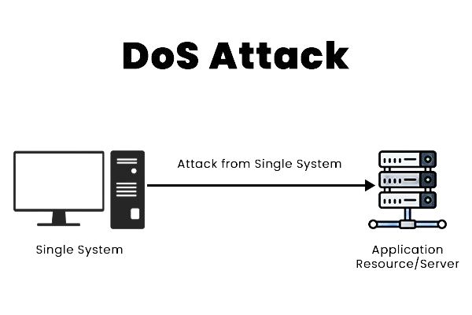
23.2.3 Denial of Service (DoS)
The primary focus of a DoS attack is to oversaturate the capacity of a targeted machine.
DoS is a form of attack that prevents users from accessing normal services, such as e-mail and a web server.
Here, the system is busy responding to abnormally large amounts of requests.
Attackers send enough requests for a system resource that the requested service is overloaded and ceases to operate.
Types: Ping of Death, E-mail Bomb.

Slide 4
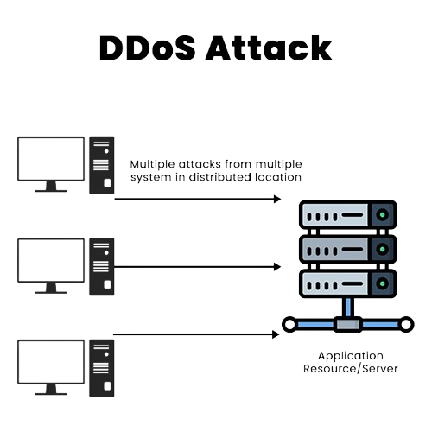
Distributed DoS (DDoS)
Distributed DoS (DDoS) is another form of attack that uses many infected computers, called zombies (Bots), to launch an attack.
With DDoS, the intent is to obstruct or overwhelm access to the targeted server.
Zombie computers located at different geographical locations make it difficult to trace the origin of the attack.

Slide 5
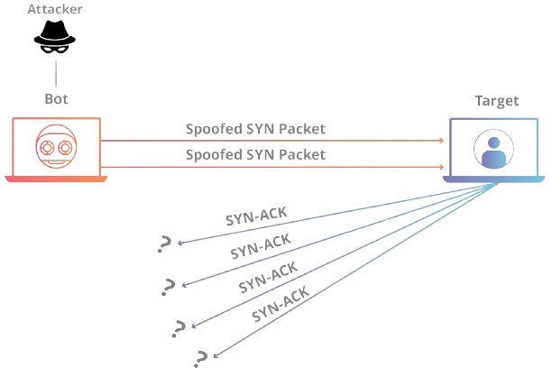
SYN flood
A SYN flood (half-open attack) is a type of Denial-of-Service attack which aims to make a server unavailable to legitimate traffic by consuming all available server resources.
The attacker sends a high volume of SYN packets to the targeted server, often with spoofed IP addresses.
The server then responds to each one of the connection requests and leaves an open port ready to receive the response.
While the server waits for the ACK to receive it is called the TCP Half-Open State and it utilizes high CPU and RAM, which in turn makes the server to go into a state where it cannot respond to legitimate request.

Slide 6
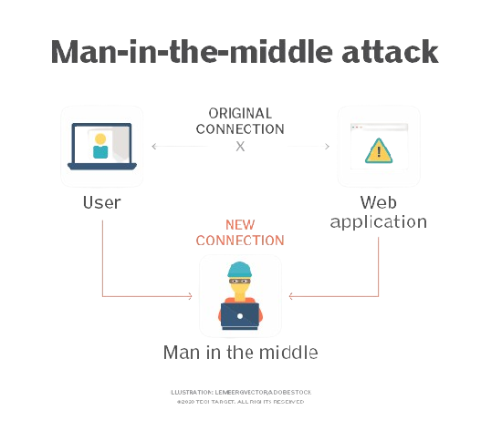
Man-in-the-middle
A man-in-the-middle (MitM) attack is a type of cyber attack in which the attacker secretly intercepts and relays messages between two parties who believe they are communicating directly with each other.
The device in MitM intercepts the packets and is sniffed using
sniffer software's like Wireshark.
MitM cyber attacks pose a serious threat to online security because they give the attacker the ability to capture and manipulate sensitive personal information such as login credentials, account details or credit card numbers in real time.

Slide 7
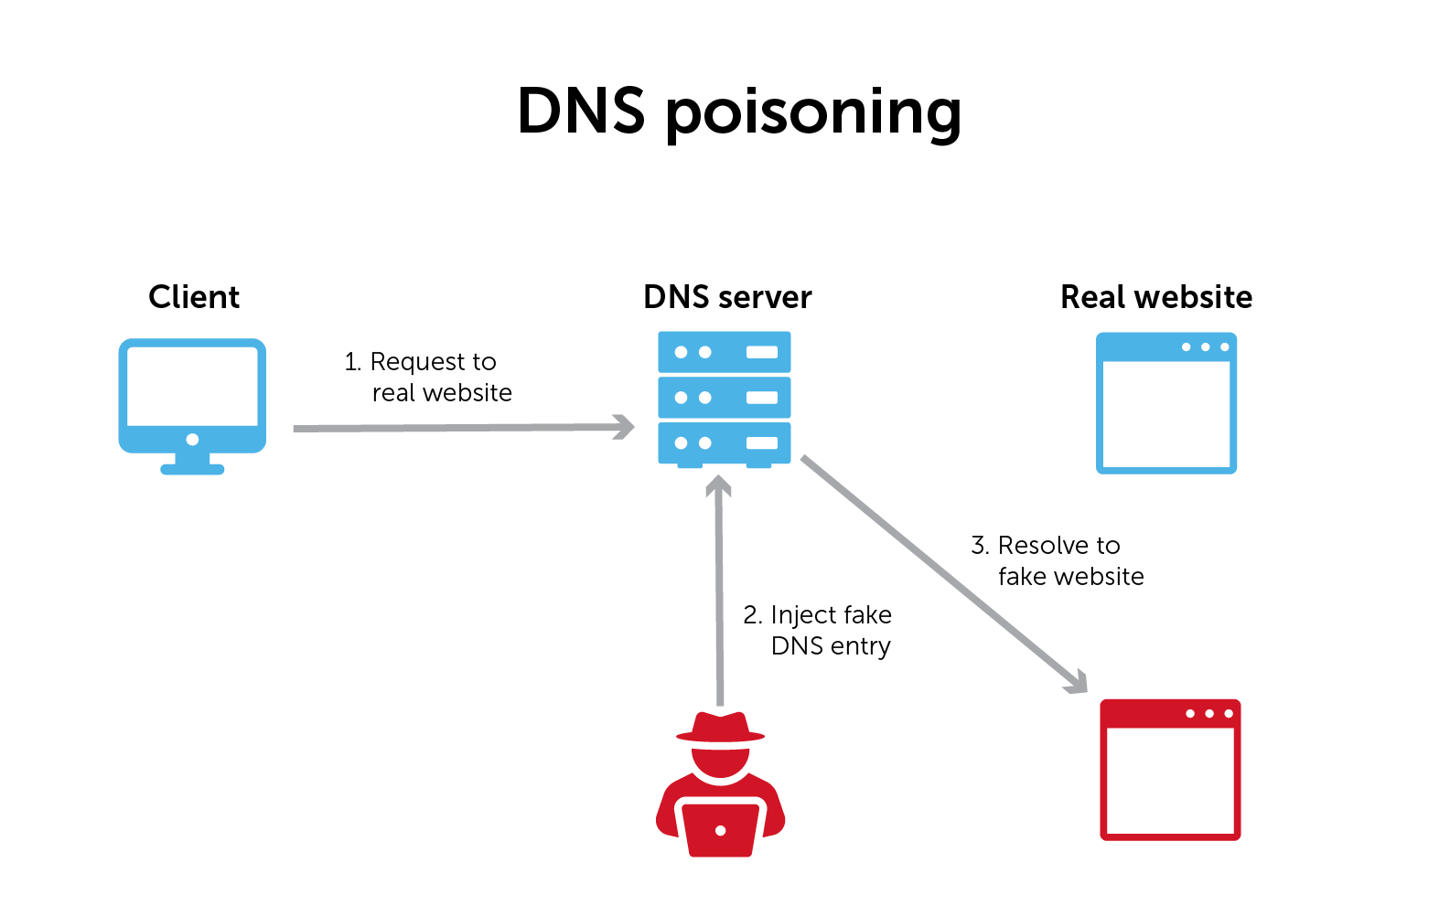
DNS poisoning
Changes the DNS records on a system to point to false servers where the data is recorded.
In DNS Poisoning attack , all the traffic that is mean to be sent to www.example.com which has an IP address of A.A.A.A , will be sent to a fake www.example.com residing at an IP address of B.B.B.B.
This makes easier for the attacker to obtain usernames, passwords and other valuable information's of users by trapping them into false server of the attacker.

Slide 8
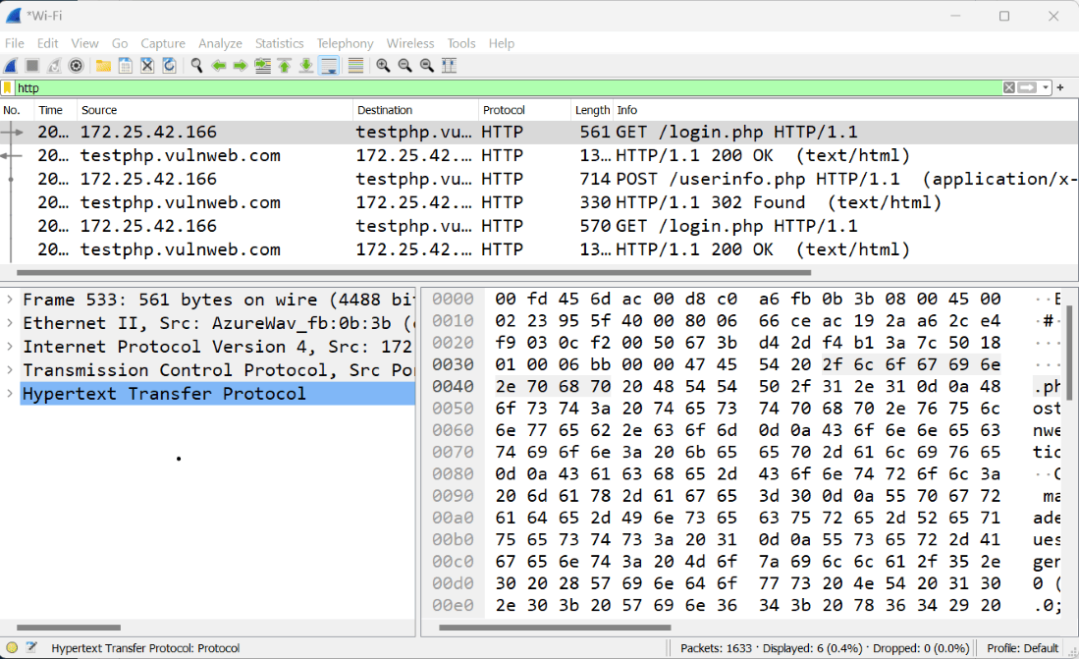
Sniffing
The technique of capturing all data packets traveling through a network using a software application or hardware device is known as network sniffing.
A sniffing attack occurs when an attacker uses a packet sniffer to intercept and read sensitive data passing through a network

Slide 9

23.2.5 Social Engineering
A social engineer is a person who is able to gain access to equipment or a network by tricking people into providing the necessary access information.
They gains confidence of an employee and convinces them to disclose username and password information.
A social engineer might pose as a technician to try to gain entry into a facility.
When inside, the social engineer might look over shoulders to gather information, seek out papers on desks with passwords and phone extensions, or obtain a company directory with e-mail addresses.

Slide 10
23.2.5 Social Engineering
Basic precautions
Never give out your password.
Always ask for the ID of unknown persons.
Restrict access of unexpected visitors.
Never post your password in your work area.
Lock your computer when you leave your desk.
Do not let anyone follow you through a door that requires an access card.

Slide 11
Phishing
Phishing is a form of social engineering where the attacker pretends to represent a legitimate outside organization, such as a bank.
A potential victim is contacted via e-mail, messaging apps,etc
For security, use the postal service to share sensitive information.

Slide 12
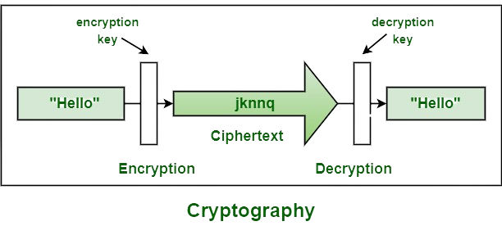
Cryptography
Cryptography is the process of hiding or coding information so that only the person a message was intended for can read it.
Data is encrypted at the sender side and decrypted in the receiver side using a key.

Slide 13
Wireless Security Techniques
Change default SSID and default password of the router.
Do not share your password and make the password that is not easy to guess.
Use strong encryption. There are WEP, WPA, WPA2 and WPA3 encryption. Use WPA3 if possible.
Use MAC-filtering to restrict unauthorised users.
Update firmware of your Access-Point or Wireless router.

Slide 14
How to be secure from attacks
Do not use protocols which does not use encryption like HTTP, FTP,etc.
Use strong password and regularly change your password.
Use services that provide end-to-end encryption.
Use two-way authentication.
Avoid using Wi-Fi access points which you do not think are secure like public Wifi’s.
Always verify the other user if he/she is legitimate and never share your passwords, OTP (One Time Password) to others.
Secure your device using anti-virus software and other preventive software.
Do not download software's from untrusted websites.
Do not click on links that are suspicious.

Slide 15
End of Lecture 25

